Slide 1
Getting Started with Deep Learning
Jason Colón

Slide 2
Introduction to Deep Learning

Slide 3
The Biological Neuron
Inputs
Output

Slide 4
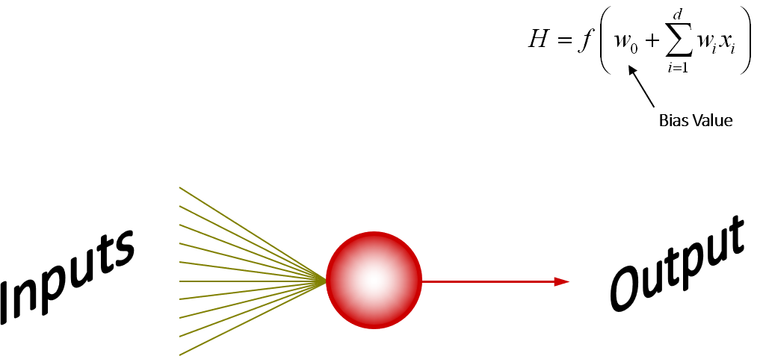
The Mathematical Neuron
The mathematical neuron has two parts:
Combination function (pre-activation)
Activation function

Slide 5
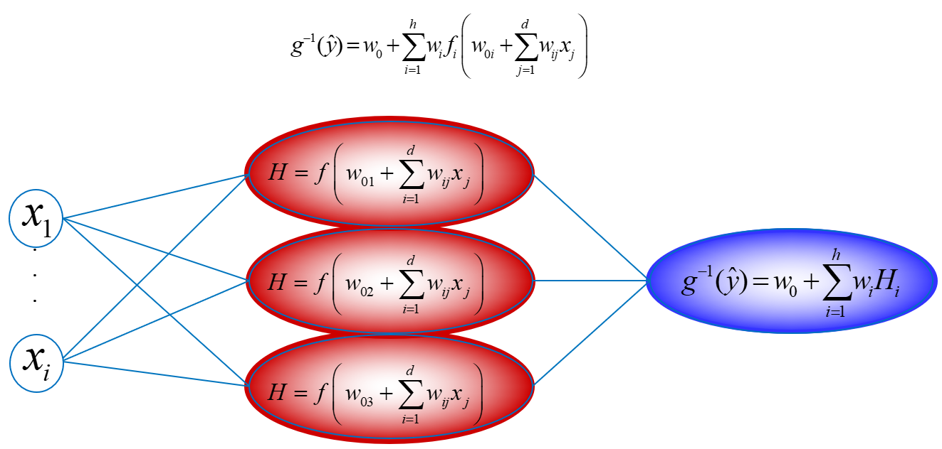
Multilayer Perceptron

Slide 6
Aspect
Traditional
Deep Learning
1
Hidden Activation Function(s)
1
1
Rectified Linear (ReLU) and other variants
Hyperbolic Tangent (tanh)
2
2
2
Stochastic GD, RMS Prop, and ADAM
Gradient-based Learning
Batch GD and BFGS
3
3
3
Normalized Variance
Weight Initialization
Constant Variance
4
4
4
Early Stopping, L1/L2,
Dropout, and Batch Norm
Regularization
Early Stopping, L1 and L2

Slide 7
Deep Learning Applications
Medicine
Forecasting
Natural Language Processing
Computer Vision
Speech Recognition
Entertainment

Slide 8




SAS Deep Learning Tools
Controller
Worker
Worker
Worker
CAS

Slide 9
Computer Vision

Slide 10
Computer Vision Tasks
Image
Classification
Object
Detection
Semantic
Segmentation
Neural Network is used to predict the class of the image.
Neural Network is used to identify objects and their location in an image.
Neural Network is used to determine what class all pixels in an image belong to.

Slide 11

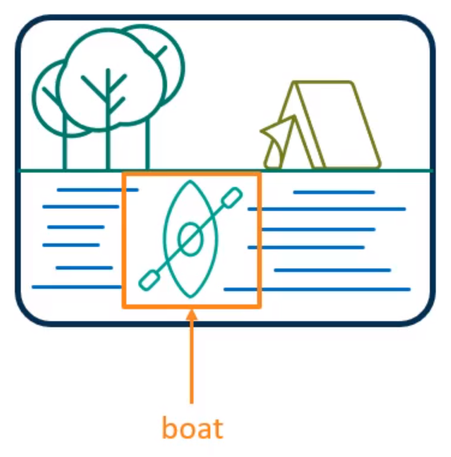


Computer Vision Tasks
Object
Detection
= background
= forklifts
= trees
= conveyor belts

Slide 12
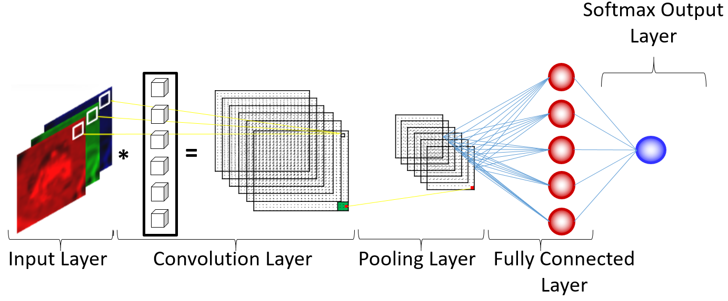
Convolutional Neural Networks

Slide 13
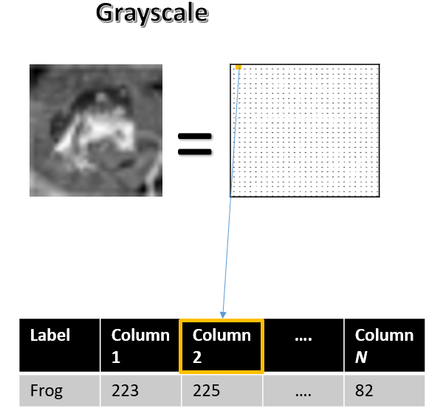
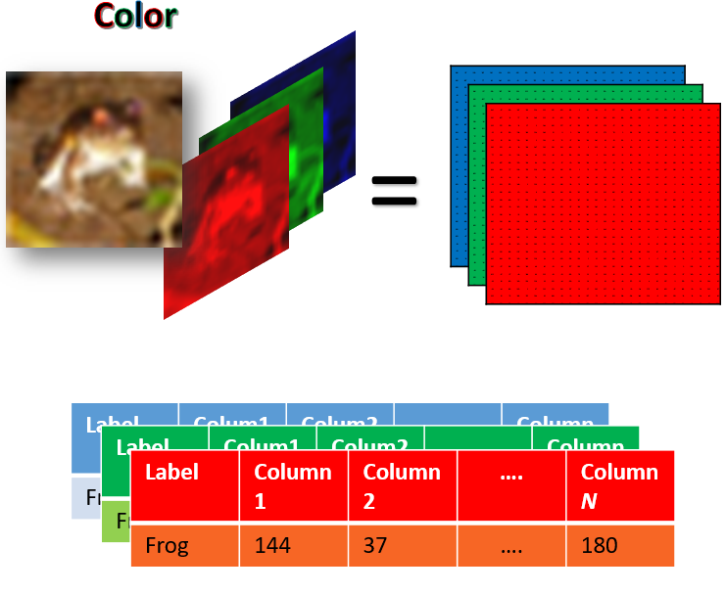
Convolutional Neural Networks
Input Layers

Slide 14
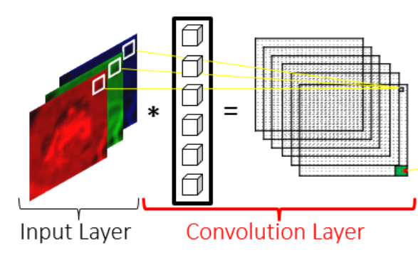
Convolutional Neural Networks
Convolutional Layers

Slide 15
Single Input Channel: 6 * 6
245 | 97 | 239 | 187 | 195 | 254
185 | 207 | 11 | 77 | 93 | 246
212 | 175 | 160 | 11 | 27 | 2
33 | 2 | 0 | 0 | 0 | 0
140 | 0 | 0 | 0 | 4 | 2
226 | 152 | 49 | 18 | 193 | 247
Filter: 3 * 3
Feature Map
1 | 1 | 1
0 | 0 | 0
-1 | -1 | -1
Bias
*
+
10
=

Slide 16
Single Input Channel: 6 * 6
245 | 97 | 239 | 187 | 195 | 254
185 | 207 | 11 | 77 | 93 | 246
212 | 175 | 160 | 11 | 27 | 2
33 | 2 | 0 | 0 | 0 | 0
140 | 0 | 0 | 0 | 4 | 2
226 | 152 | 49 | 18 | 193 | 247
Filter: 3 * 3
Feature Map
?
44
1 | 1 | 1
0 | 0 | 0
-1 | -1 | -1
Bias
*
+
10
=
245
+ 97
+ 239
+ 0
+ 0
+ 0
- 212
- 175
- 160
+ 10
= 44

Slide 17
Single Input Channel: 6 * 6
Stride = 1
245 | 97 | 239 | 187 | 195 | 254
185 | 207 | 11 | 77 | 93 | 246
212 | 175 | 160 | 11 | 27 | 2
33 | 2 | 0 | 0 | 0 | 0
140 | 0 | 0 | 0 | 4 | 2
226 | 152 | 49 | 18 | 193 | 247
Filter: 3 * 3
Feature Map
?
44 | 187
44
1 | 1 | 1
0 | 0 | 0
-1 | -1 | -1
Bias
*
+
10
=
97
+ 239
+ 187
+ 0
+ 0
+ 0
- 175
- 160
- 11
+ 10
= 187

Slide 18
Single Input Channel: 6 * 6
Stride = 1
245 | 97 | 239 | 187 | 195 | 254
185 | 207 | 11 | 77 | 93 | 246
212 | 175 | 160 | 11 | 27 | 2
33 | 2 | 0 | 0 | 0 | 0
140 | 0 | 0 | 0 | 4 | 2
226 | 152 | 49 | 18 | 193 | 247
Filter: 3 * 3
Feature Map
44 | 187 | 433
1 | 1 | 1
0 | 0 | 0
-1 | -1 | -1
Bias
*
+
10
=
239
+ 187
+ 195
+ 0
+ 0
+ 0
- 160
- 11
- 27
+ 10
= 433

Slide 19
Single Input Channel: 6 * 6
Stride = 1
245 | 97 | 239 | 187 | 195 | 254
185 | 207 | 11 | 77 | 93 | 246
212 | 175 | 160 | 11 | 27 | 2
33 | 2 | 0 | 0 | 0 | 0
140 | 0 | 0 | 0 | 4 | 2
226 | 152 | 49 | 18 | 193 | 247
Filter: 3 * 3
Feature Map
44 | 187 | 433 | 606
1 | 1 | 1
0 | 0 | 0
-1 | -1 | -1
Bias
*
+
10
=
187 + 195 + 254 + 0 + 0 + 0 – 11 – 27 – 2 + 10 = 606

Slide 20
Single Input Channel: 6 * 6
Stride = 1
245 | 97 | 239 | 187 | 195 | 254
185 | 207 | 11 | 77 | 93 | 246
212 | 175 | 160 | 11 | 27 | 2
33 | 2 | 0 | 0 | 0 | 0
140 | 0 | 0 | 0 | 4 | 2
226 | 152 | 49 | 18 | 193 | 247
Filter: 3 * 3
Feature Map
44 | 187 | 433 | 606
378
1 | 1 | 1
0 | 0 | 0
-1 | -1 | -1
Bias
*
+
10
=
185 + 207 + 11 + 0 + 0 + 0 – 33 – 2 – 0 + 10 = 378

Slide 21
Single Input Channel: 6 * 6
Stride = 1
245 | 97 | 239 | 187 | 195 | 254
185 | 207 | 11 | 77 | 93 | 246
212 | 175 | 160 | 11 | 27 | 2
33 | 2 | 0 | 0 | 0 | 0
140 | 0 | 0 | 0 | 4 | 2
226 | 152 | 49 | 18 | 193 | 247
Filter: 3 * 3
Feature Map
44 | 187 | 433 | 606
378 | 303 | 191 | 426
417 | 356 | 204 | 44
-382 | -207 | -250 | -448
1 | 1 | 1
0 | 0 | 0
-1 | -1 | -1
Bias
*
+
10
=

Slide 22
Single Input Channel: 6 * 6
Stride = 1
245 | 97 | 239 | 187 | 195 | 254
185 | 207 | 11 | 77 | 93 | 246
212 | 175 | 160 | 11 | 27 | 2
33 | 2 | 0 | 0 | 0 | 0
140 | 0 | 0 | 0 | 4 | 2
226 | 152 | 49 | 18 | 193 | 247
Filter: 3 * 3
Feature Map
44 | 187 | 433 | 606
378 | 303 | 191 | 426
417 | 356 | 204 | 44
-382 | -207 | -250 | -448
w1 | w2 | w3
w4 | w5 | w6
w7 | w8 | w9
Bias
*
+
=

Slide 23
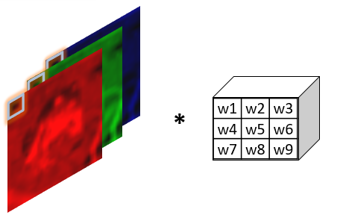

Three Channel Input:
Reference:
Filter: 3 * 3
=
28 weights
32 * 32 * 3
30 * 30

Slide 24

Padding
Single Input Channel: 6 * 6
Without Padding
Feature Map:
4 * 4
245 | 97 | 239 | 187 | 195 | 254
185 | 207 | 11 | 77 | 93 | 246
212 | 175 | 160 | 11 | 27 | 2
33 | 2 | 0 | 0 | 0 | 0
140 | 0 | 0 | 0 | 4 | 2
226 | 152 | 49 | 18 | 193 | 247
Filter: 3 * 3
n | n | n | n
n | n | n | n
n | n | n | n
n | n | n | n
w1 | w2 | w3
w4 | w5 | w6
w7 | w8 | w9
*
=
Stride = 1

Slide 25
Padding
Single Input Channel: 6 * 6
With Padding
0 | 0 | 0 | 0 | 0 | 0 | 0 | 0
0 |  |  |  |  |  |  | 0
0 |  |  |  |  |  |  | 0
0 |  |  |  |  |  |  | 0
0 |  |  |  |  |  |  | 0
0 |  |  |  |  |  |  | 0
0 |  |  |  |  |  |  | 0
0 | 0 | 0 | 0 | 0 | 0 | 0 | 0
Feature Map:
6 * 6
245 | 97 | 239 | 187 | 195 | 254
185 | 207 | 11 | 77 | 93 | 246
212 | 175 | 160 | 11 | 27 | 2
33 | 2 | 0 | 0 | 0 | 0
140 | 0 | 0 | 0 | 4 | 2
226 | 152 | 49 | 18 | 193 | 247
Filter: 3 * 3
n | n | n | n | n | n
n | n | n | n | n | n
n | n | n | n | n | n
n | n | n | n | n | n
n | n | n | n | n | n
n | n | n | n | n | n
w1 | w2 | w3
w4 | w5 | w6
w7 | w8 | w9
*
=
Stride = 1

Slide 26
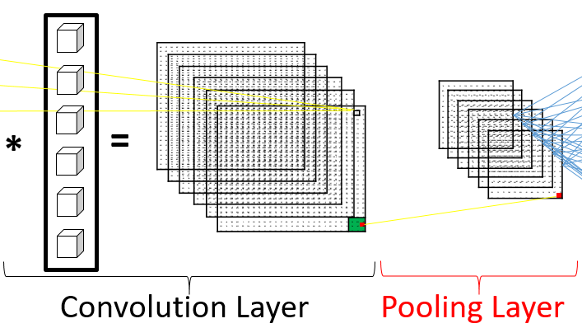
Convolutional Neural Networks
Pooling Layers
Maximum Pooling
368
Feature Map
34 | 171 | 418 | 519
368 | 293 | 181 | 416
407 | 346 | 198 | 40
-393 | -217 | -260 | -485
Average Pooling
216.5
Minimum Pooling
34

Slide 27

Convolutional Neural Networks
Feature Map Dimensions
Output Output
x
where
is the input dimension.
is the padding dimension.
is the filter dimension.
is the stride.

Slide 28
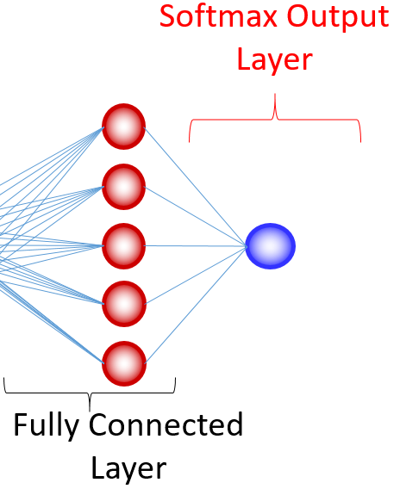
Convolutional Neural Networks
Fully Connected Layers

Slide 29
Network Architectures
Choose the Appropriate Architecture
Classification
ResNetX
DenseNetX
DarkNet
ShuffleNetvX
Detection
YOLOvX
Tiny_YolovX
Segmentation
UNet
ENet

Slide 30
Deep Learning Process
1
Define Task
3
Train and Assess
Define your business objective and what your model needs to achieve.
Train and assess your models on your data. This may involve using pre-trained weights.
2
Choose an Architecture
4
Deploy
Choose a set of architectures proven to work on your tasks
Deploy your model using something like SAS ESP or SAS Model Manager

Slide 31
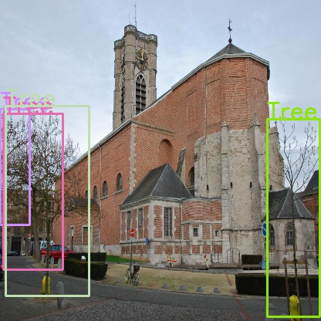
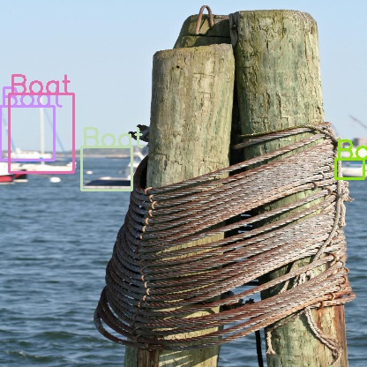
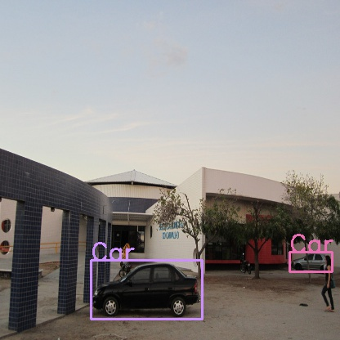
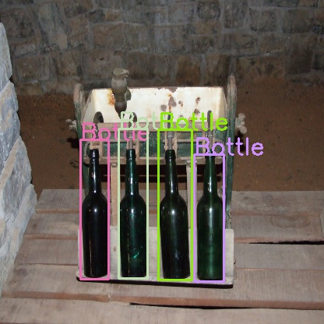
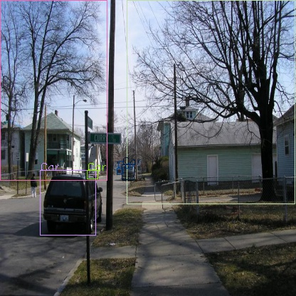
Object Detection

Slide 32

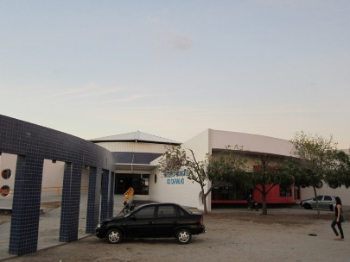
Object Detection
YOLO Annotations and Data Format
_image_ | _nObjects_ | _Object0_ | _Object0_ x | _Object0_ y | _Object0_width | _Object0_ height | ……….
 | 1 | Truck | .53 | .41 | .88 | .96 | ……..
 | 3 | Person | .80 | .81 | .09 | .21 | ……..
_nObjects_ - The number of objects in the picture.
_Objectn_x – Corresponds to the normalized horizontal location of the object.
_Objectn_y – Corresponds to the normalized vertical location of the object.
_Objectn_width – Corresponds to the normalized width of the bounding box.
_Objectn_height – Corresponds to the normalized height of the bounding box.

Slide 33
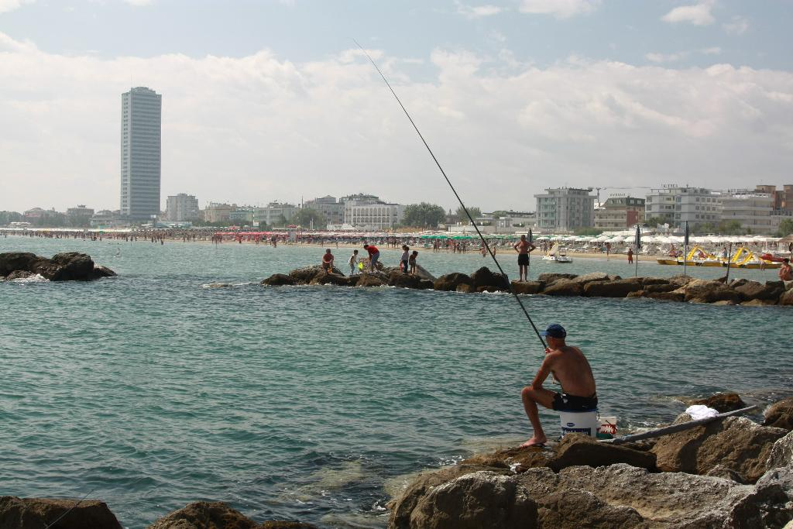
Object Detection
Normalized Locations
_image_ | _nObjects_ | _Object0_ | _Object0_ x | _Object0_ y | _Object0_width | _Object0_ height | ……….
 | 3 | Person | .80 | .81 | .09 | .21 | ……..
0,0.
.
.1,1

Slide 34
Object Detection
Normalized Bounding Box
_image_ | _nObjects_ | _Object0_ | _Object0_ x | _Object0_ y | _Object0_width | _Object0_ height | ……….
 | 3 | Person | .80 | .81 | .09 | .21 | ……..
0,0.
.
.1,1

Slide 35
Object Detection
Normalized Bounding Box
_image_ | _nObjects_ | _Object0_ | _Object0_ x | _Object0_ y | _Object0_width | _Object0_ height | ……….
 | 3 | Person | .80 | .81 | .09 | .21 | ……..
0,0.
.1,1

Slide 36
Object Detection
Anchor Boxes
= Ground truth
.
= Anchor box

Slide 37
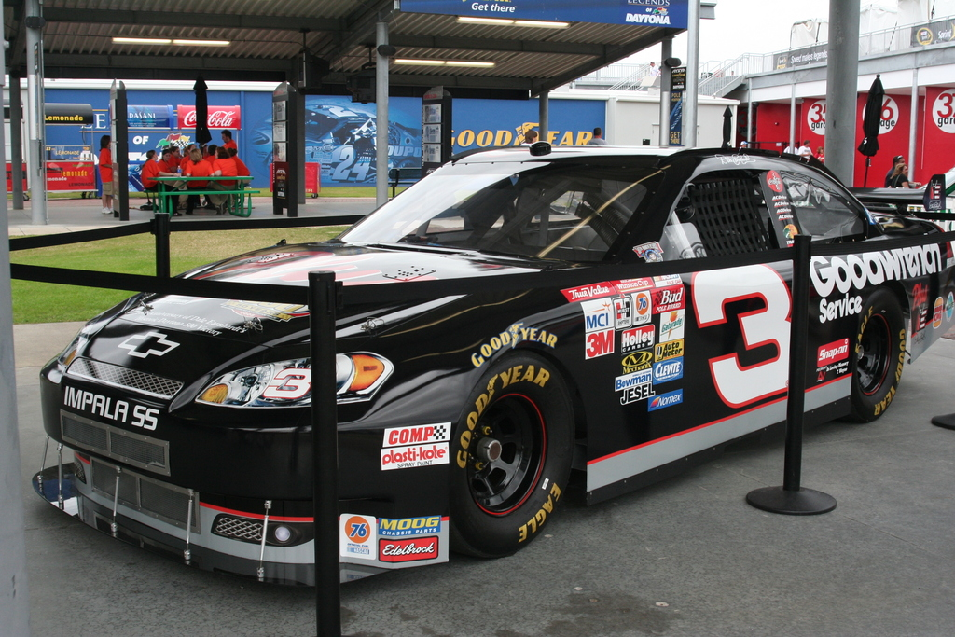


Object Detection
Anchor Boxes
Used as starting position for bounding box
=
Multiple priors of different sizes should be used of varying orientations and shapes
Good priors can improve prediction performance

Slide 38
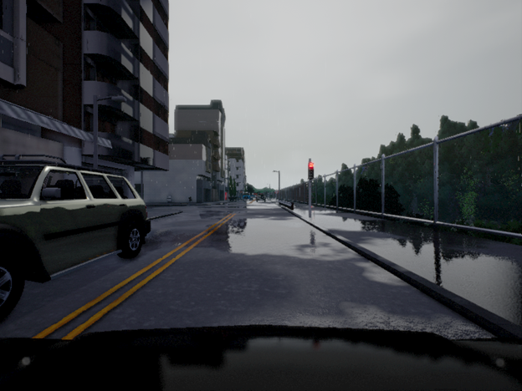
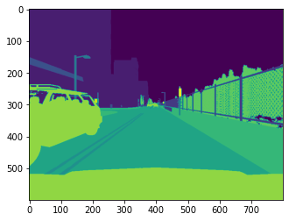
Segmentation
Predict

Slide 39
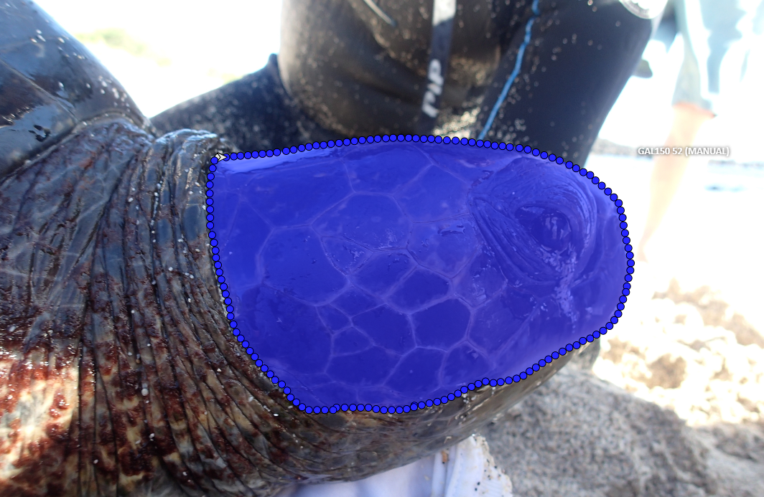

Segmentation
Annotations
Yields

Slide 40
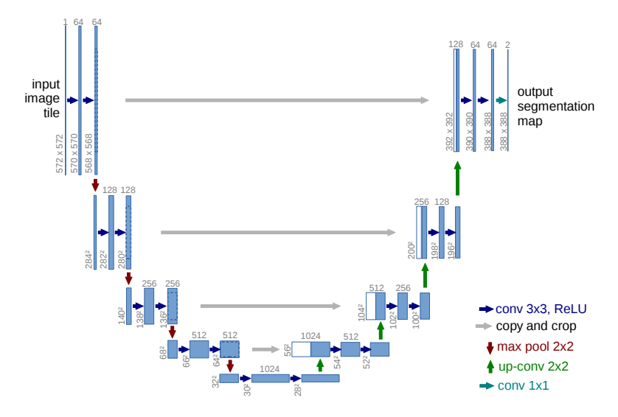
Segmentation
U-Net Model

Slide 41

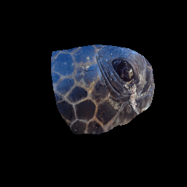
Segmentation
Output
Raw
Processed
Applied

Slide 42
Natural Language Processing

Slide 43
NLP Tasks
Text
Classification
Machine
Translation
Text
Generation
Neural Network are used to predict what category a sequence of text belongs to.
Neural Networks are used to translate from one input language to another.
Neural Networks generate new text given text as an input.

Slide 44
Recurrent Neural Networks
X_{a}
Y_{a}
X_{b}
Y_{b}
sequence data
Input layer
hidden layer
output layer

Slide 45
Recurrent Neural Networks
Y_{t}
Y₀
Y₁
Y_{t}
H
=
H₀
H₁
H_{t}
X_{t}
X₀
X₁
. . .
X_{t}
Input layer
hidden layer
output layer

Slide 46
Recurrent Neural Networks
Variations
GRU
LSTM
Y_{t}
Y_{t}
Y_{t-1}
Y_{t+1}
Y_{t-1}
Y_{t+1}
i_{t}
u_{t}
f_{t}
H_{t-1}
s_{t}
H_{t+1}
H_{t-1}
s_{t}
H_{t+1}
r_{t}
g_{t}
H_{t}
X_{t-1}
o_{t}
X_{t+1}
X_{t-1}
X_{t+1}
H_{t}
X_{t}
X_{t}

Slide 47
Transformer Overview
output probabilities
softmax
linear
add & norm
feed forward
add & norm
add & norm
feed forward
multi-head attention
N_{x}
N_{x}
add & norm
add & norm
multi-head attention
masked multi-head attention
positional encoding
+
+
positional encoding
input embedding
output embedding
inputs
outputs (shifted right)

Slide 48
Deep Learning Demo

Slide 49




April 16-19, 2024 // ARIA Las Vegas
SAS Training Tutorial Materials:
Getting Started with Deep Learning
jason.colon@sas.com
Notes:
QR code: SIGSMM Getting Started with Deep Learning

